Slide 1
Shipping & Receiving Management Application
OZARKS TECHNICAL COMMUNITY COLLEGE
Jesse Fender & Kalin Bowden

Slide 2
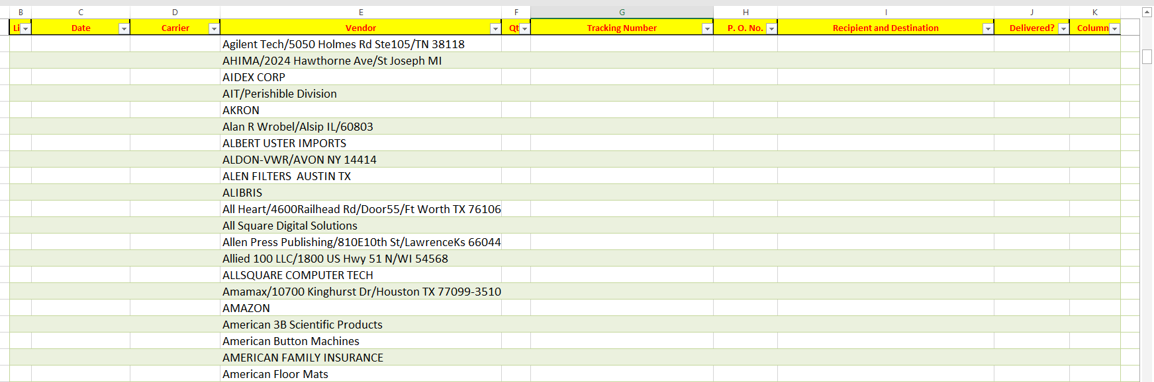
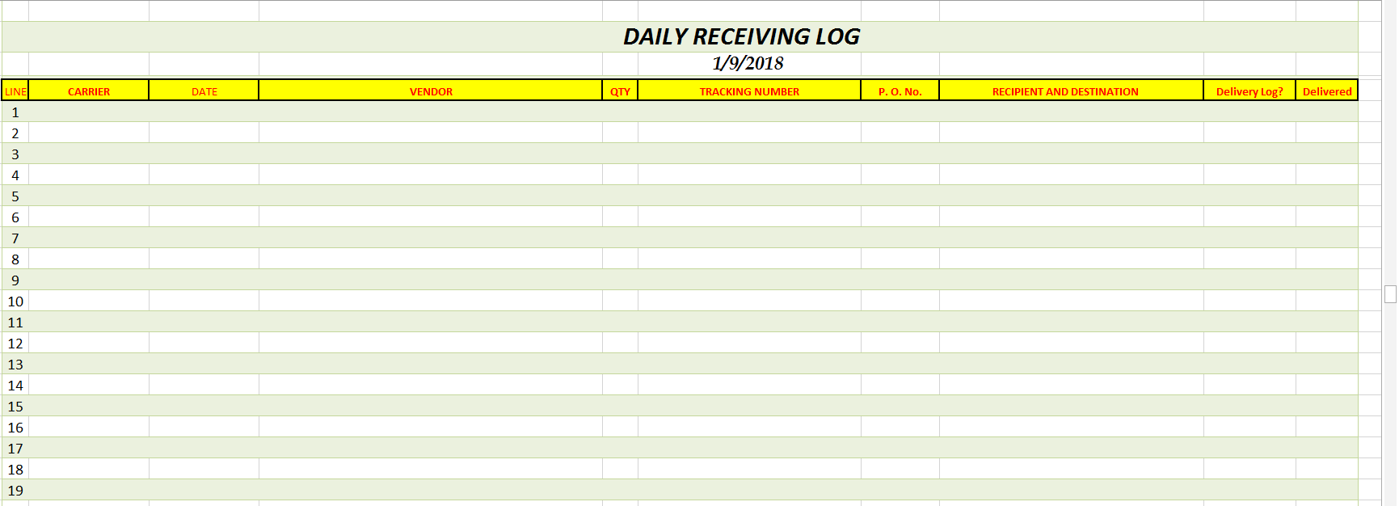
Used Excel to store all information
Had to manually input each line of items from a PO or Invoice
Could not track more than 80 items per page, if more than that receiving must manually create a second log and save it as a separate file

Slide 3
DEMo

Slide 4
Changes & Enhancements
APPLICATION
Dropped Reports
Added Package History
Added Manage History
DATABASE
MySQL & MSSQL
Auto Backup
Database Regeneration

Slide 5
Q&A

